Slide 1

Approximation Algorithms
Prasanta K. Jana, IEEE Senior Member
Department of Computer Science and Engineering
Indian Institute of Technology (ISM), Dhanbad, India
E-mail: prasantajana@yahoo.com

Slide 2
Approximation Algorithm
What is an Approximation Algorithm?
An algorithm that returns near optimal solution.
What is the Motivation?
NP-complete problems.
Two approaches:
1) For small size problem, an exponential running time algorithm may be satisfactory.
2) Find a near optimal algorithm.

Slide 3
Approximation Algorithm
Comment:
The second approach gives the birth of an approximation algorithm.
How to evaluate it?
Performance bound: An approximation algorithm has a ratio bound of f (n) if
Where n is input size
C: Cost of the approximation algorithm
and C* : Cost of the optimal solution

Slide 4
The Vertex Cover Problem:
Statement: A vertex cover of an undirected graph G= (V, E) is a subset V' ⊆V such that if (u, v) ∈E, then either u ∈ V' or v ∈ V' or both. It is to find a vertex cover of minimum size.

Slide 5
Vertex Cover Algorithm
APPROX-VERTEX COVER (G)
{
C = Φ
E' = E [G]
While E' ≠ Φ do
let (u,v) be an arbitrary edge of E'
C = C ∪ {u, v}
Remove from E' every edge incident on either u or v
Return C
}
Running Time: O(E)
Near Optimality: The above algorithm returns a vertex cover whose size is guaranteed to be no more than twice the size of an optimal vertex cover.

Slide 6

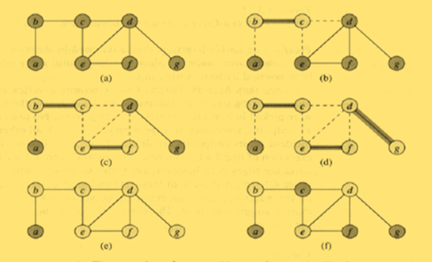
An Illustration
An Illustration
Fig. (a):Input Graph
Fig. (e): Final Vertex Cover C = {b, c, e, f, d, g}
Fig. (f):The Optimal vertex cover {b, e, d}
Comments: Optimal Sol. is almost half of Approx. Sol.

Slide 7
The Travelling Sales Person Problem
Statement: Given a complete undirected graph G=(V,E) that has a non-negative integer cost C(u,v) associated with each edge (u,v)∈E, find a Hamiltonian cycle of G with minimum cost.
APPROX-TSP-TOUR (G, C)
Select a vertex r ∈V(G) to be a root vertex
Grow a minimum spanning tree T for G from the root r.
Let L be the list of vertices in a preorder walk of T.
Return the Hamiltonian cycle H that visits the vertices in the order L.
Time complexity: O (|v²|) as step 2 requires O (|v²|) time using prim’s algorithm.

Slide 8
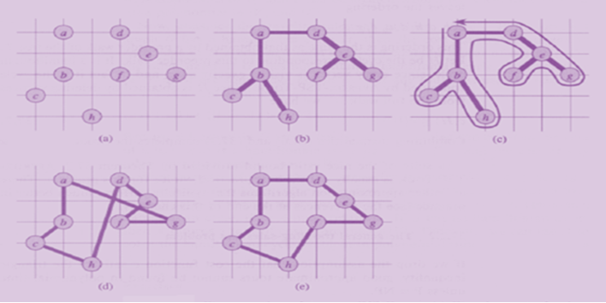
An Illustration
Fig. (a): Input Grid Fig. (b): MST Fig.(c): A preorder walk {a, b, c, b, h, b, a, d, e, f, e, g, e, d, a}
Fig. (d): Approx. Tour {a, b, c, h, d, e, f, g, a}of Cost 19.074
Fig. (e): Optimal Tour of Cost 14.715, 23 % shorter

Slide 9
Set-Covering Problem:
Statement: An instance(X, F) of the set-covering problem consists of a finite set X and a family F of subsets of X such that every element of X belongs to at least one subset in F:
We say that a subset S ∈ F covers its elements. The problem is to find a minimum-size subset whose members covers all of X:
We say that C satisfying (1) covers X.

Slide 10
Set-Covering Problem:
Applications: In many commonly arising combinatorial problems
An Example:
X: Set of skills required to implement a project
We have a given set of people available to work on the project
We wish to form committee with minimum people such that every skill in X, there is a member of the committee with that skill.

Slide 11
Set-Covering Problem:
Algorithm Greedy-Set-cover(X, F)
{
While U≠ Φ
Do select an S ∈F that maximizes |S∩U|
{
}
Return C
}
Time complexity:
While loop in min (|X|, |F|)
Do Loop in O(|X||F|).
Therefore, it is O (|X||F| min (|X|, |F|)).

Slide 12
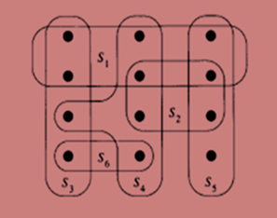
Set-Covering Problem:
An Illustration:
X Consists of 12 black points
F= {S₁, S₂, S₃, S₄, S₅, S₆}
Minimum Size Set Cover: C = {S₃, S₄, S₅}
Greedy Approximation Sol: {S₁, S₄, S₅, S₃}

Slide 13
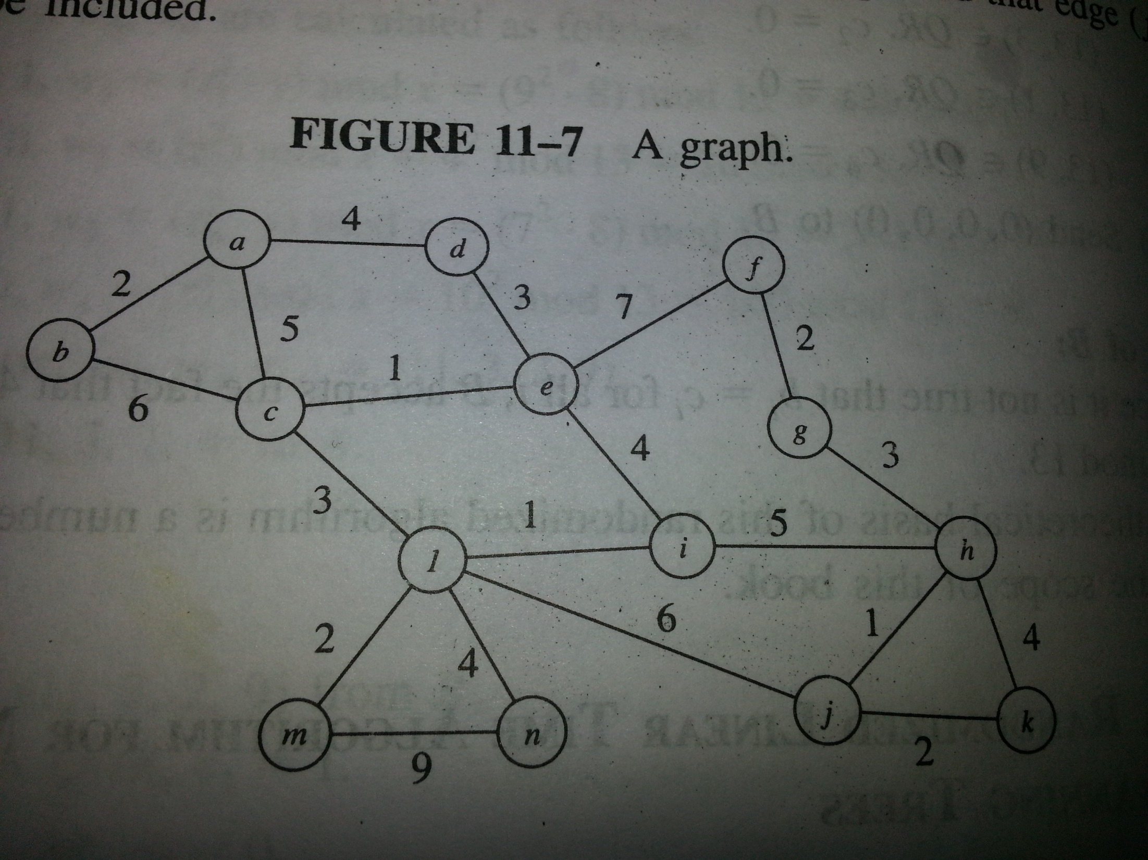

Slide 14
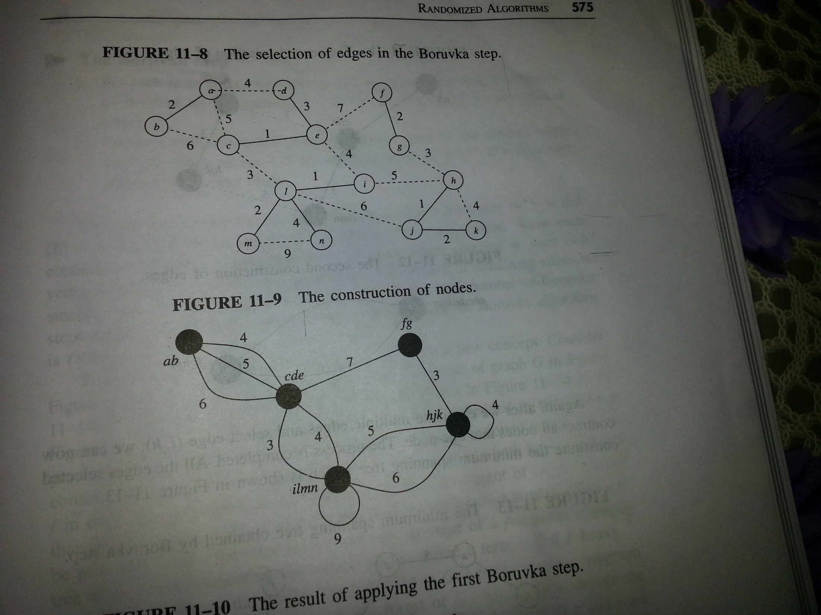

Slide 15
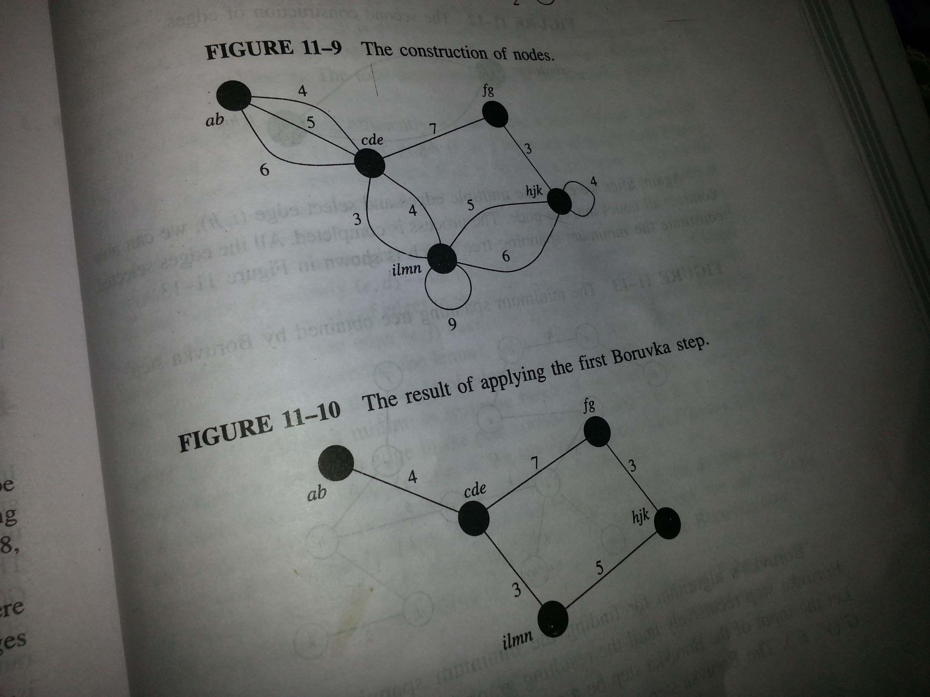

Slide 16
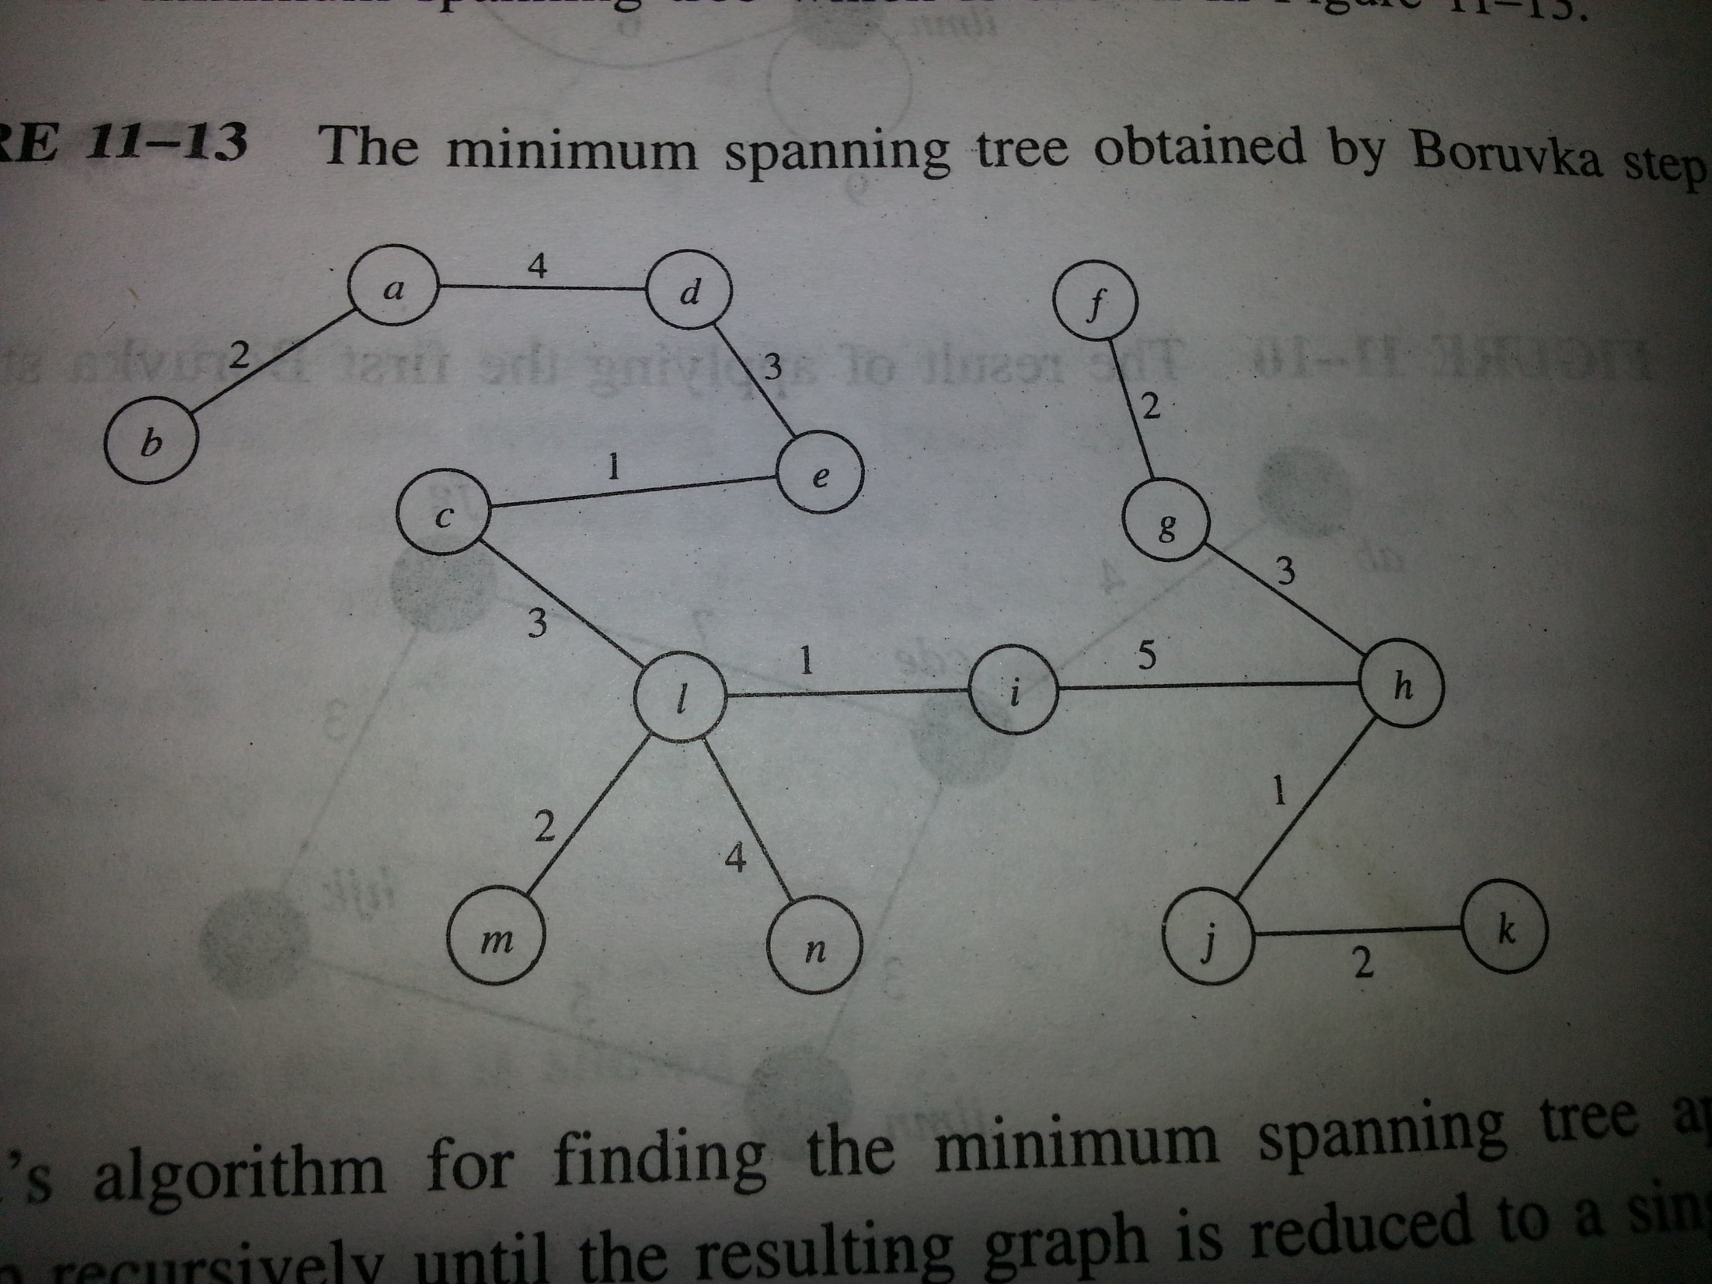

Slide 17
